Slide 1
Hella ingredients Meal Generator
Leah Rogers, Liam Slyne, Jia Lin, Robert Renecker

Slide 2
Methodology

Slide 3
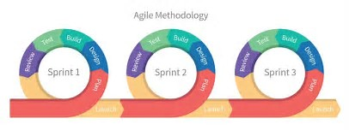
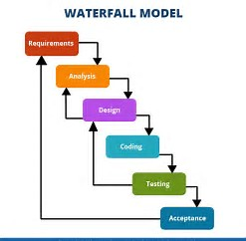
Agile/WaterFall

Slide 4
Project tracking

Slide 5

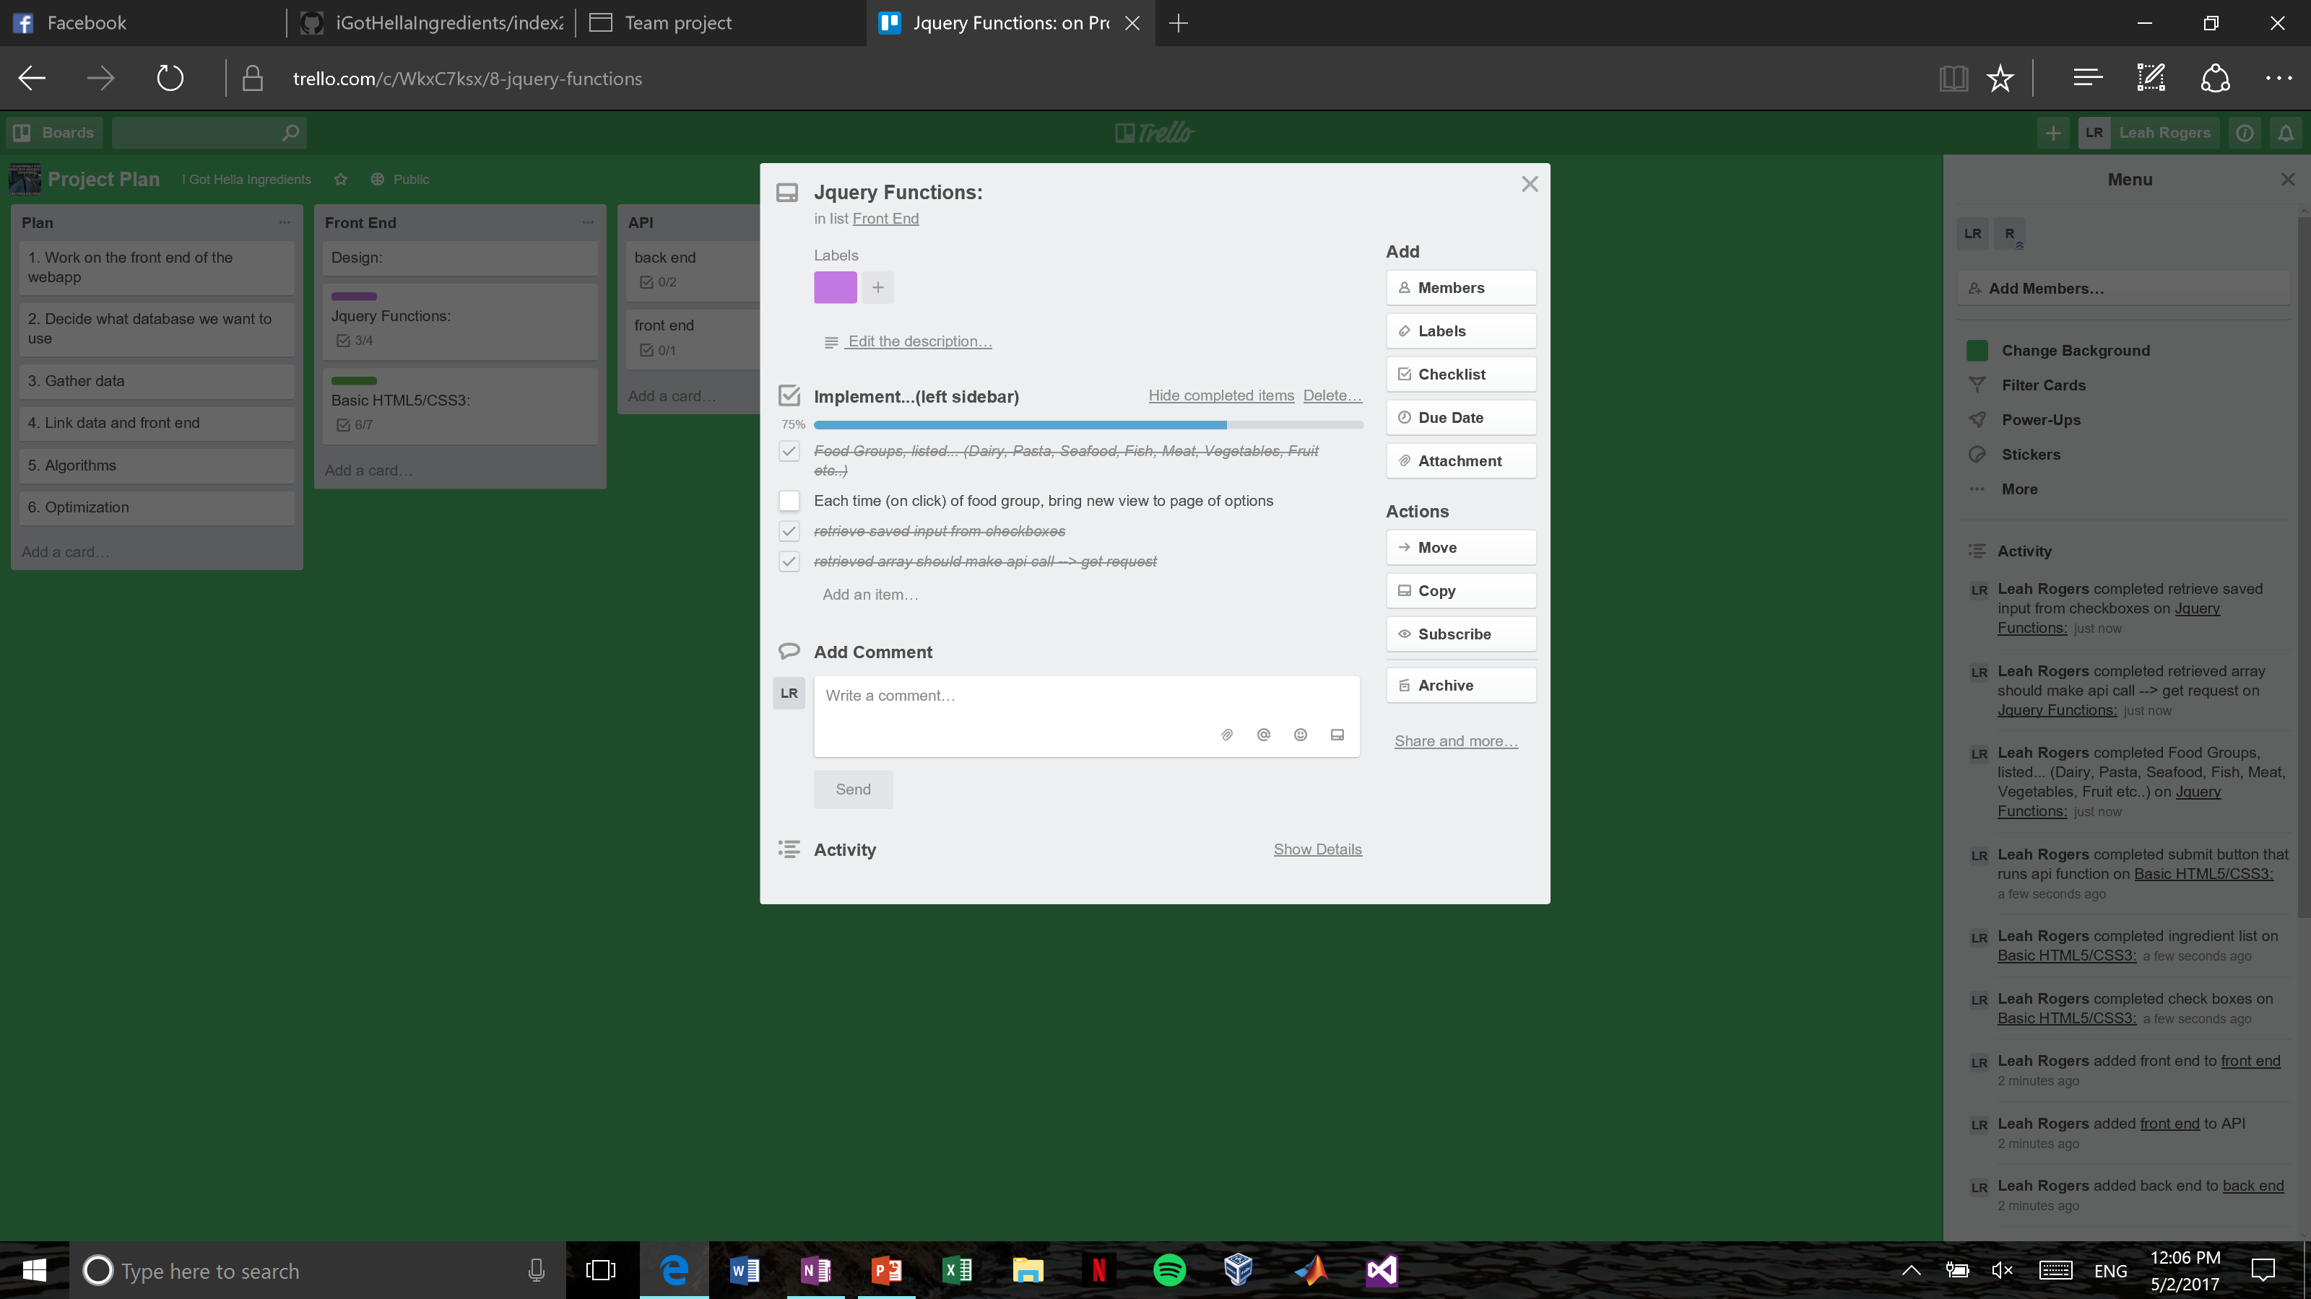
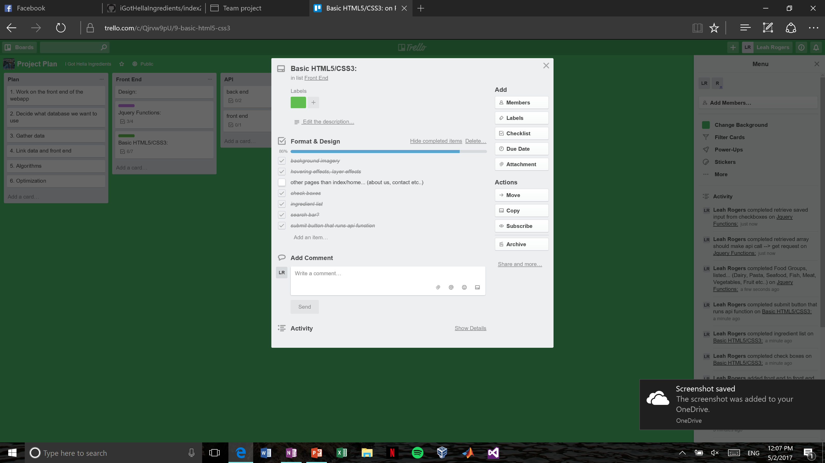
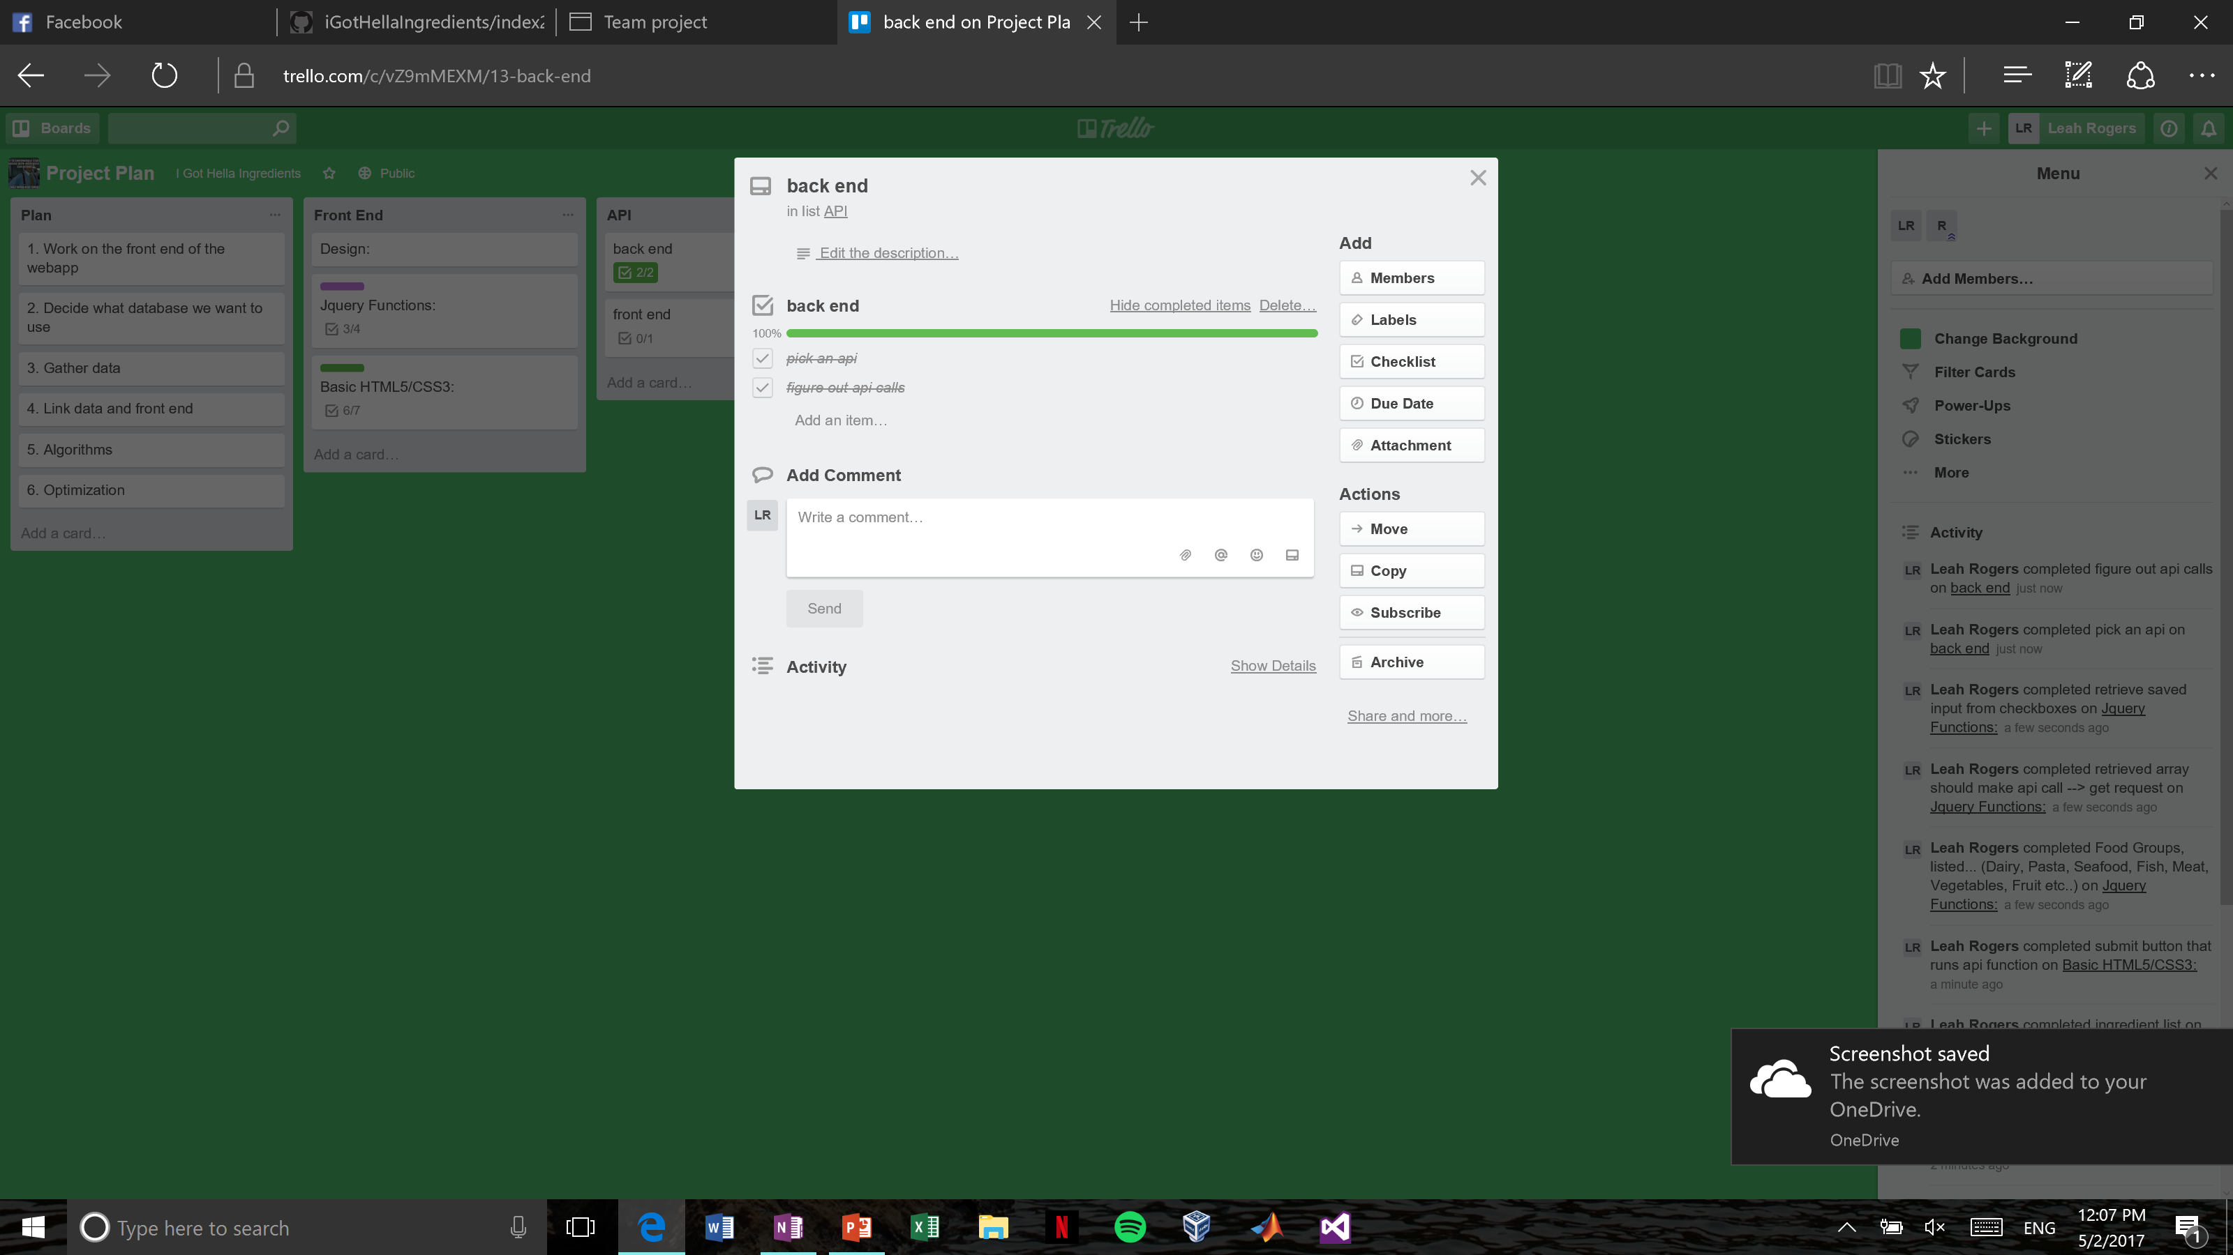

Slide 6
REpository

Slide 7
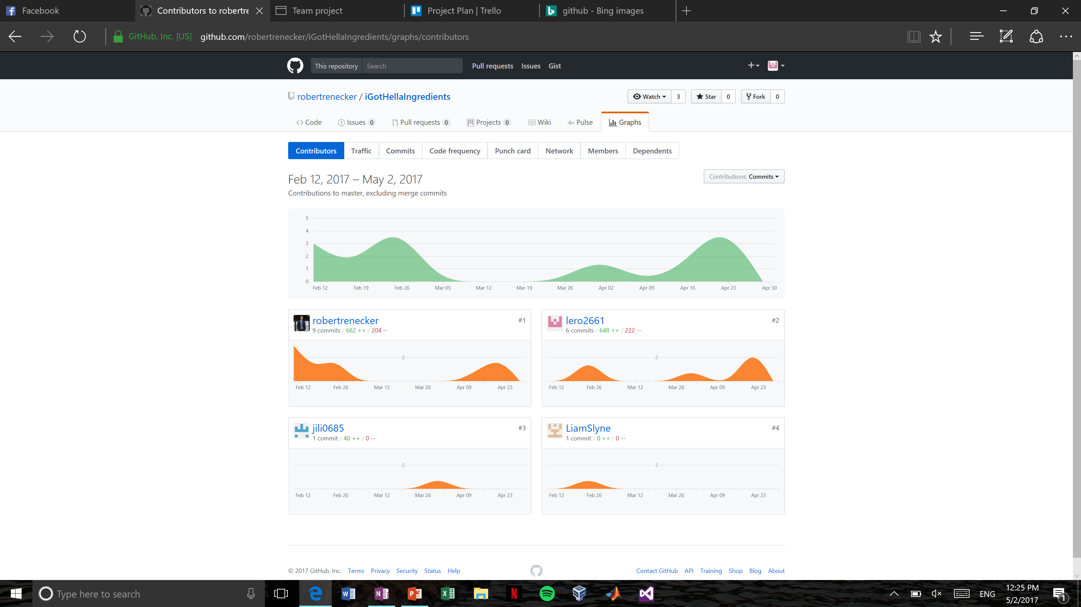

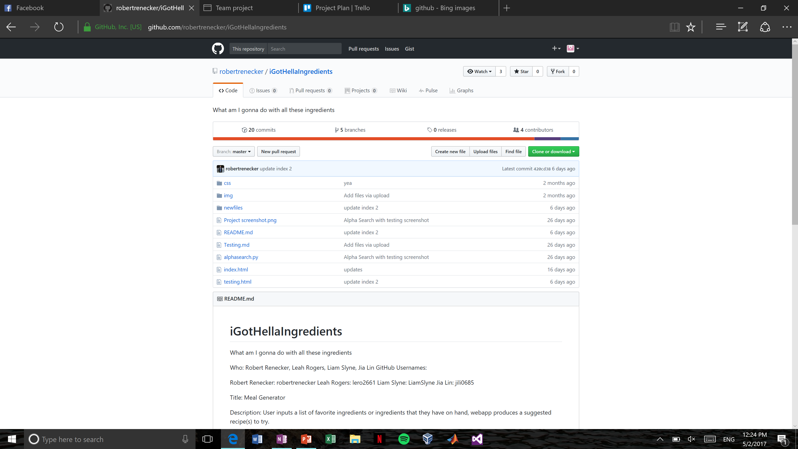
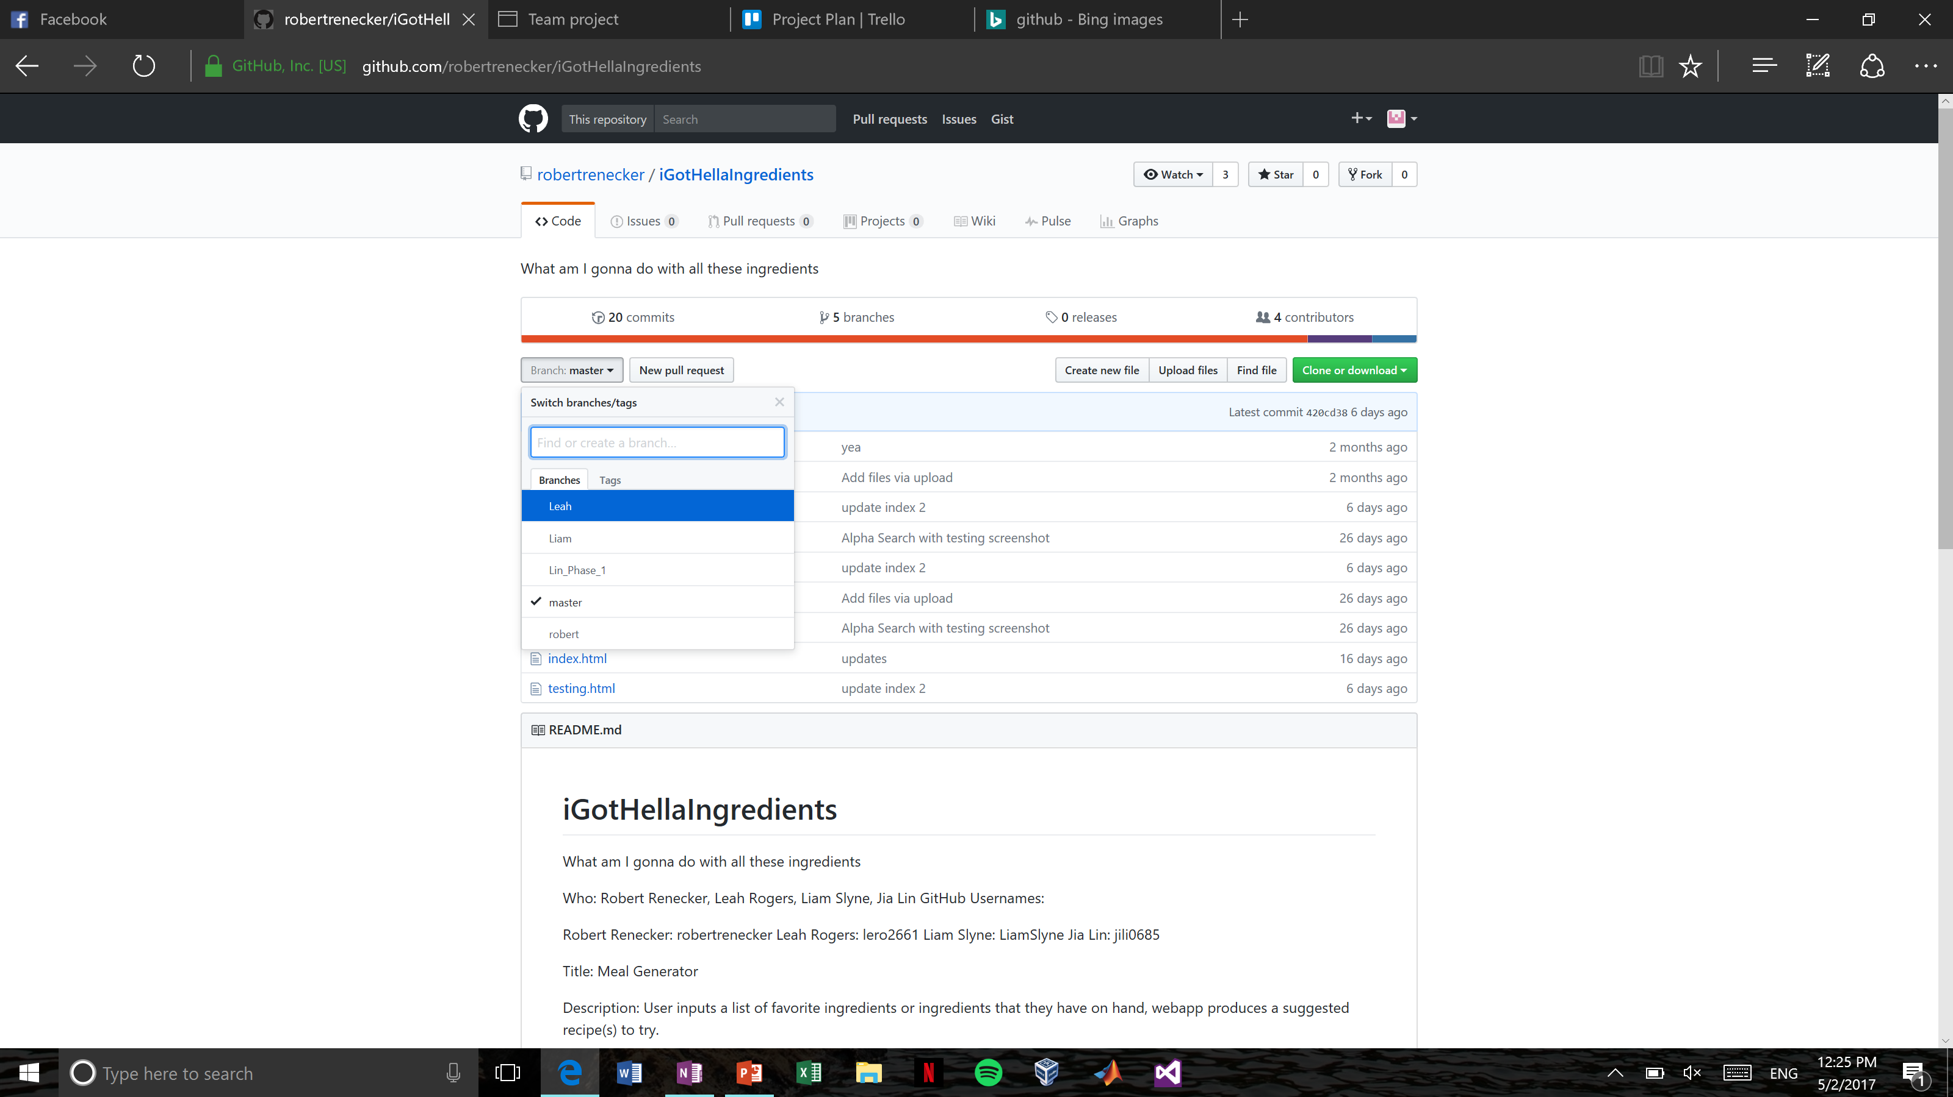

Slide 8
API

Slide 9


Slide 10
Code Editing

Slide 11



ATOM
VISUAL STUDIO
SUBLIME TEXT

Slide 12
Testing

Slide 13


Slide 14
Auto Documentation

Slide 15


Slide 16
Demo

